Slide 1

Pop-Up Notification for Hold Shelf Items
CERV Enhancement (ID# 247150)
Yoel Kortick | June 2026

Slide 2
Agenda
Introduction
An example before this development
Using the new configuration
An example after this development

Slide 3
Introduction

Slide 4
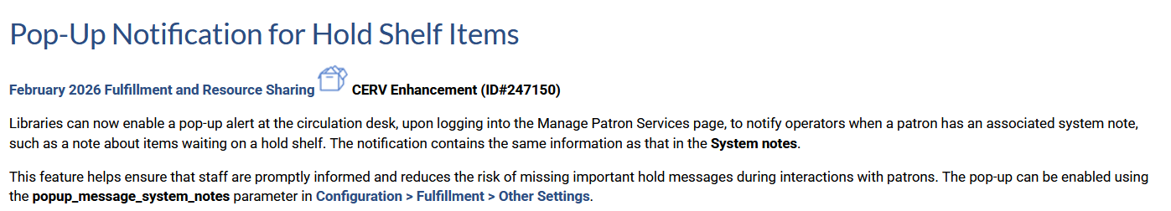
Introduction

Slide 5
Introduction
As of the May 2026 release it is possible to configure Alma to present a pop-up alert after retrieving a patron via "Manage Patron Services".
The pop-up alert will contain the contents of the "System Notes".
The enabling of the pop-up alert feature helps to ensure that staff are promptly informed of the contents of the system notes.
This reduces the risk of a staff user missing important hold messages during interactions with patrons.
The pop-up can be enabled using the popup_message_system_notes parameter in Configuration > Fulfillment > Other Settings.

Slide 6
An example before this development

Slide 7
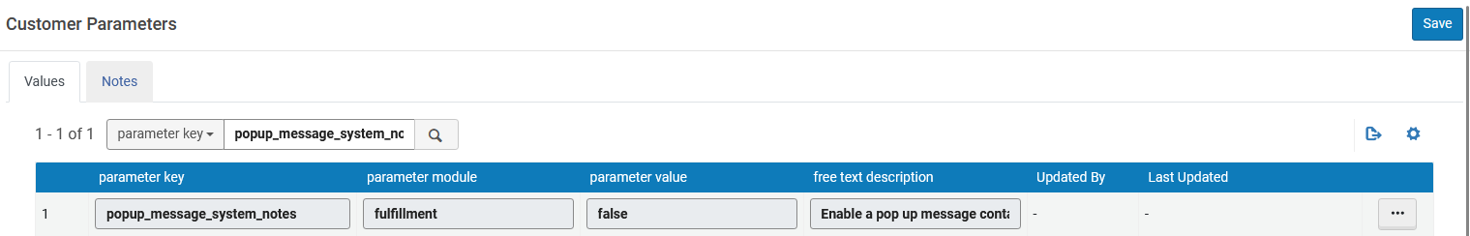
An example before this development
Currently the parameter popup_message_system_notes is "false".
Therefore, Alma is behaving as it did before the creation of this new parameter

Slide 8
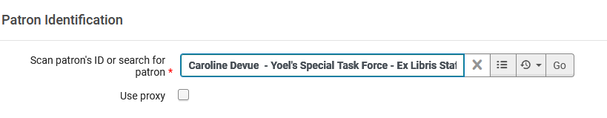
An example before this development
Patron Caroline Devue has 1 item waiting for pickup at the circulation desk.
She is retrieved via "Manage Patron Services"

Slide 9
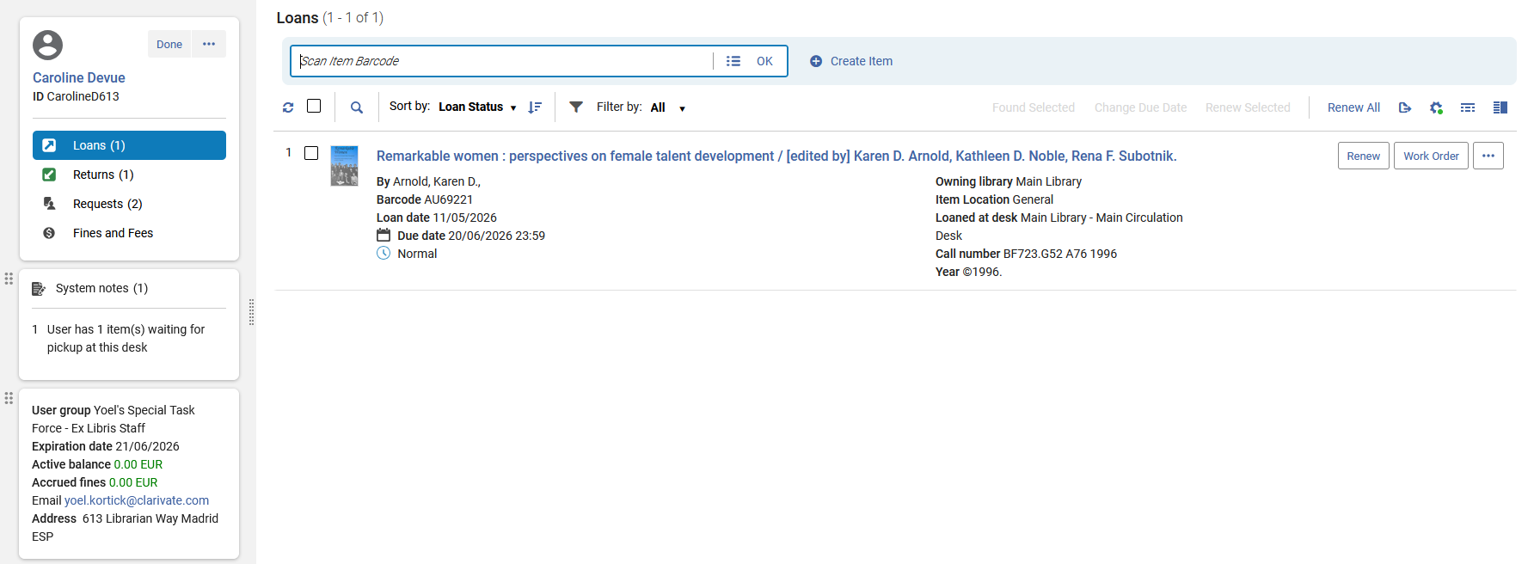
An example before this development
The staff user needs to look in the system notes to see that she has an item waiting for pickup

Slide 10
Using the new configuration

Slide 11
Using the new configuration
Parameter popup_message_system_notes has been changed from false to true
Before
After

Slide 12
An example after this development

Slide 13
An example after this development
Patron Caroline Devue has 1 item waiting for pickup at the circulation desk.
She is retrieved via "Manage Patron Services"

Slide 14
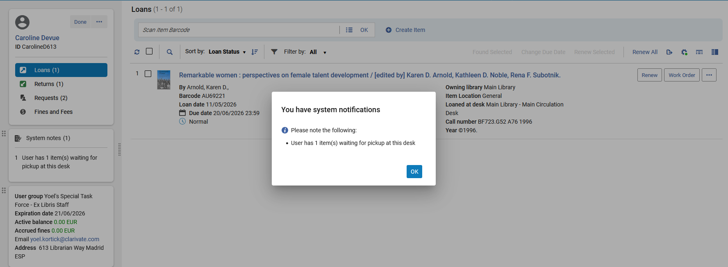
An example after this development
Upon retrieving the patron the staff user gets a pop-up notification with the system notes

